Slide 1

Time Management, Goal Setting and Project Management
Nicolas Alvarez
Ethan Moran
Saul Burgess

Slide 2



Project analysis slide 3
Time Management, Goal Setting, Project management
How the IT Industry organizes.
Use these techniques to work efficiently
Manage your projects, goals and time efficiently
Notes:
History: DO NOT SPEND LONG, TWO MINUTES MAX
Waterfall: As old as the hills, has been present for all of history. Tribal leaders, chiefs, etc
Agile: Formed in 1980’s by Agile Alliance. Designed to help with continuous integration and software dev.

Slide 3


Slide 4
Project analysis slide 3
Waterfall
Very Old, Around Forever
Agile
Began in Software Development in 1980
Notes:
History: DO NOT SPEND LONG, TWO MINUTES MAX
Waterfall: As old as the hills, has been present for all of history. Tribal leaders, chiefs, etc
Agile: Formed in 1980’s by Agile Alliance. Designed to help with continuous integration and software dev.

Slide 5
Project analysis slide 3
Agile
Scrum
Daily Standup
Decentralised Thinking
Group Accountability
Notes:
Describe Agile:
Scrum: Brain-Storming, thinking together as a group.
Daily-Standup: Daily event, what you did yesterday, what you did today, what you will do tomorrow: problems faced.
Decentralised Thinking: Related to scrum, brain-storming. Group decisions, free flowing ideas.
Group Accountability: Everybody in the group is accountable for the groups performance. As everyone had input.

Slide 6


Project analysis slide 3
Waterfall
Ease of Management
Tried and Tested
Central Responsibility
Notes:
Describe Waterfall:
Centralised Command: In contrast to agile, the project manager is the only one who makes ideas.
Leadership Responsibility: All responsibility is placed on the project manager, if the project fails. It’s their fault.
Ease of Management: As all orders come from the top, the project managers word is law. This makes things easy to manage as there is little to no objections.

Slide 7


Project analysis slide 3
Industry:
Our use:
Full Agile
Daily Stand-Ups
Full Scrums
“Tribes” and “Families”
Partial Agile
Daily Stand-Ups
Partial Scrums
“No Tribes” or “Families”
Notes:
Simply, describe how we used a cut down version of Agile and the differences between our version and industry.
Describe why we chose Agile, and why students should chose it too.
Describe why it’s used in Software Development (Continuous dev) over Waterfall.
Explain that most of the complex Agile concepts will be explained later by Nicholas and Ethan. (GROW, etc).

Slide 8
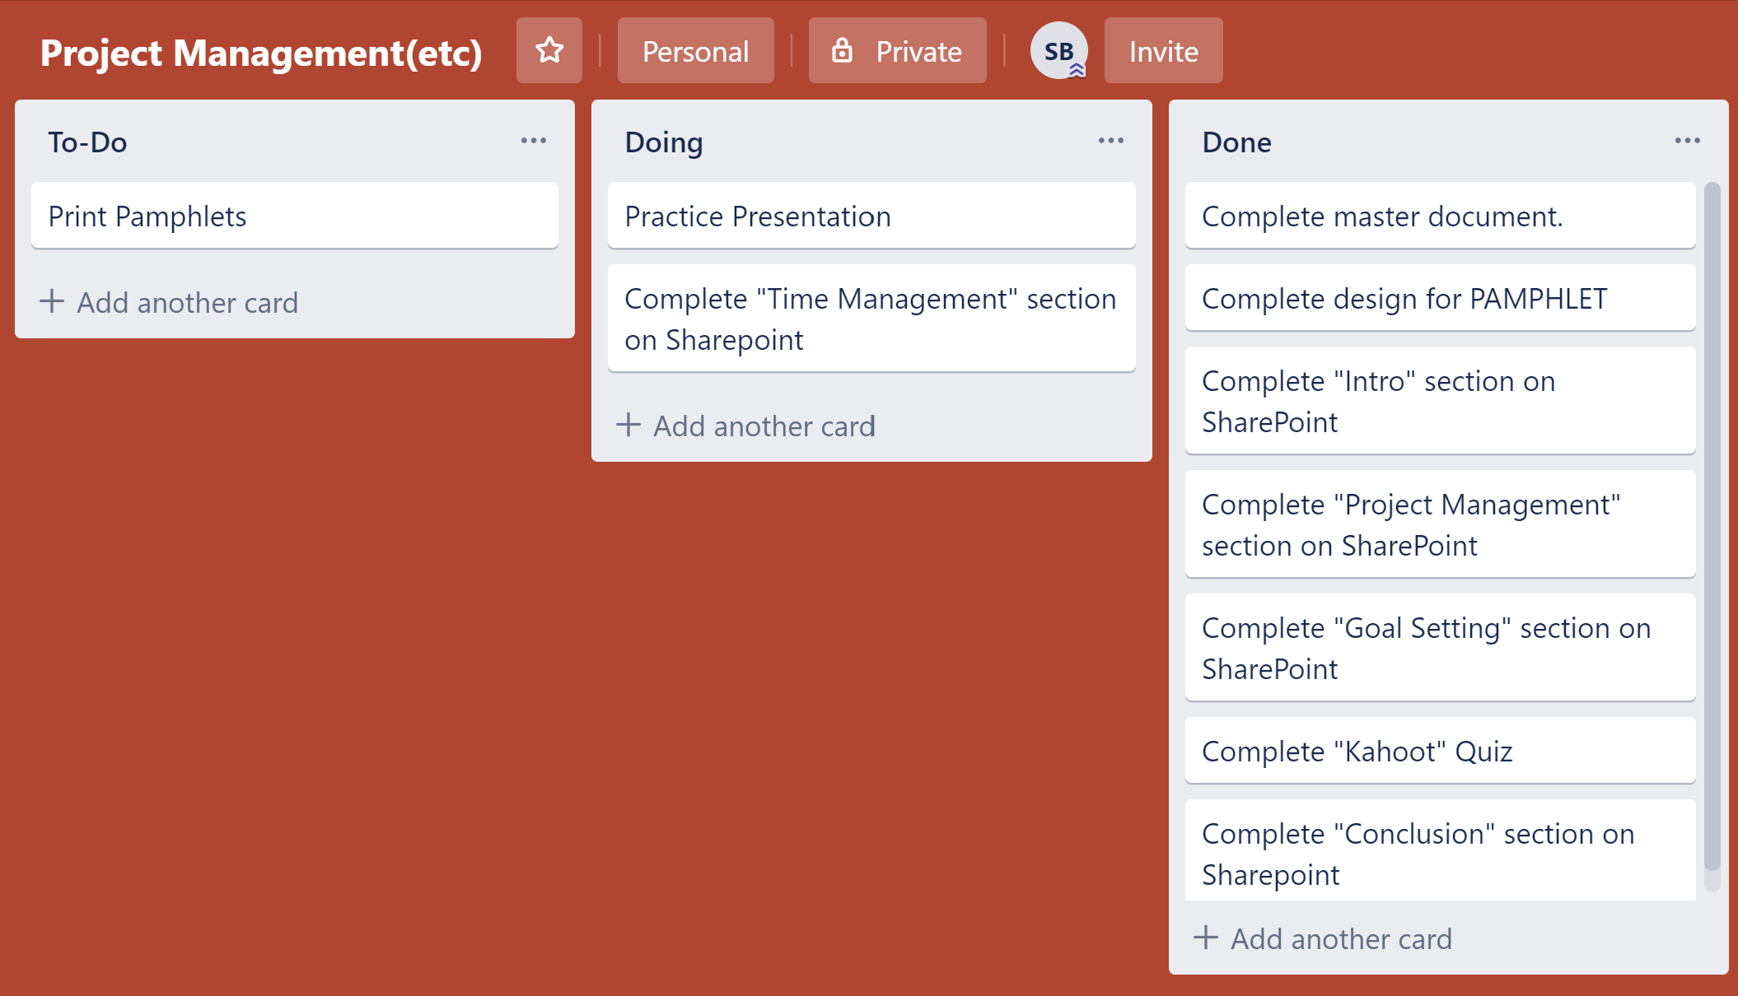
Notes:
Trello:
Talk about what Trello is.
How great Trello is.
Industry uses it to manage projects.
It is also excellent for student managed projects.

Slide 9
Project analysis slide 3
Hit the ground running.
Clear Communications.
Used Agile System.
Notes:
Describe in your own words what we did well.

Slide 10
Project analysis slide 3
Waterfall May Suit Better
Slow uptake of Agile
Sources may be Biased
Notes:
Describe in our own words what we could have improved on.

Slide 11


Slide 12


Project analysis slide 3
Goal setting – Definition.
Used by students and the workforce.
Main methods - SMART and GROW.

Slide 13
Project analysis slide 3
T
S
M
A
R
T
Specific
Measurable
Achievable
Relevant
Timely
Notes:
Specific Measurable Achievable Relevant Timely

Slide 14

SMART can be used by everyone.
Can be used by students
Can be used in the working world

Slide 15

Project analysis slide 3
Dollarsprout is a personal finance website geared toward helping millennials make smarter choices with their money.
Notes:
10% increase in search engine traffic in the next two months
S – up there
M – Re-optimize their best content and have ten new backlinks
A – Very achievable
R – very important for profit
T – 3 months is very easy

Slide 16


Specific Goal – Finding a job
Measurable – Through interviews
Achievable – With your degree
Relevant – A job is needed
Timely – Within three months

Slide 17
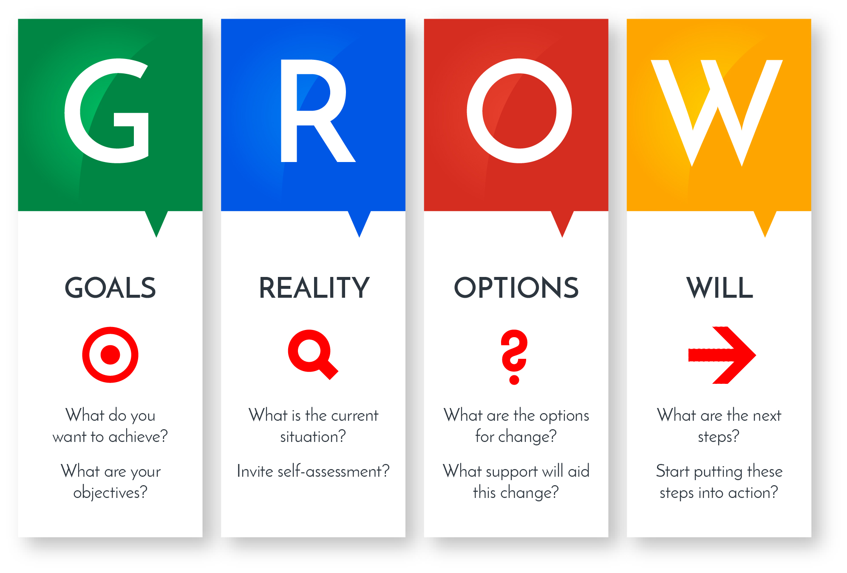

Slide 18

Project analysis slide 3
This can be used in everyday life
Can be used in the working world
The GROW Method is perfect for students
R
T
Relevant (reasonable, realistic and resourced, results-based)..
Time bound (time-based, time limited, time/cost limited, timely, time-sensitive).
Notes:
2 kg in a few months
Working world = selling more computers

Slide 19


Slide 20

Goal – Sell more computers
Reality – Not enough are being sold
Obstacles – Not enough marketing
Way forward – Raising marketing budget etc.

Slide 21
Project analysis slide 3
GROW
REALITY
OPTIONS
WAY FORWARD
GOAL
based)..
Notes:
Goal – sell more comp.
Reality – Not selling enough
Options - Hire more In the marketing team/ as engineers
Way – Specific steps such as hire two new people for the marketing team

Slide 22


Slide 23

Time management is the ability to be efficient and productive.
Is the action to maximise the overall benefit of a set fo activities
The formula that allows us to complete work in less time

Slide 24

Time Management Skills

Slide 25
Project analysis slide 10
Maintain a Master To-Do List
Learn To accept "good enough"
Break large tasks into smaller tasks
Expect interruptions
Reduce multi-tasking

Slide 26

Project analysis slide 10
Use a technique for assigning priorities to tasks
Urgent
Not Urgent
Important
Quadrant 1:
Urgent & Important
Quadrant 2:
Not Urgent & Important
Not Important
Quadrant 3:
Urgent & Not Important
Quadrant 4:
Not Urgent & Not important

Slide 27

Time Management Introduce in the IT Industry

Slide 28
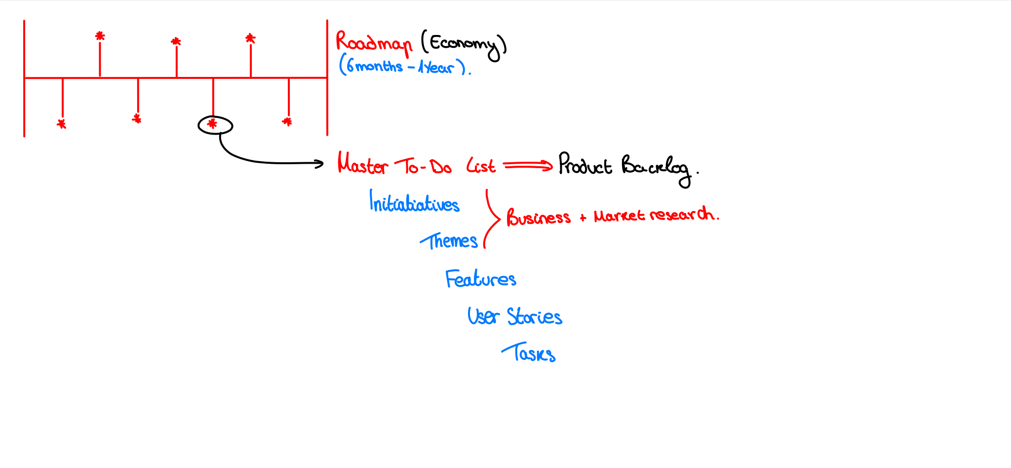
Project analysis slide 10
Notes:
The goals and aims set in the roadmap are focused on the business and economic growth of the company more than technical tasks.
The Product Backlog is divided in the following way:
1. Initiatives
2. Themes
3. Features
4. User Stories
5. Tasks

Slide 29
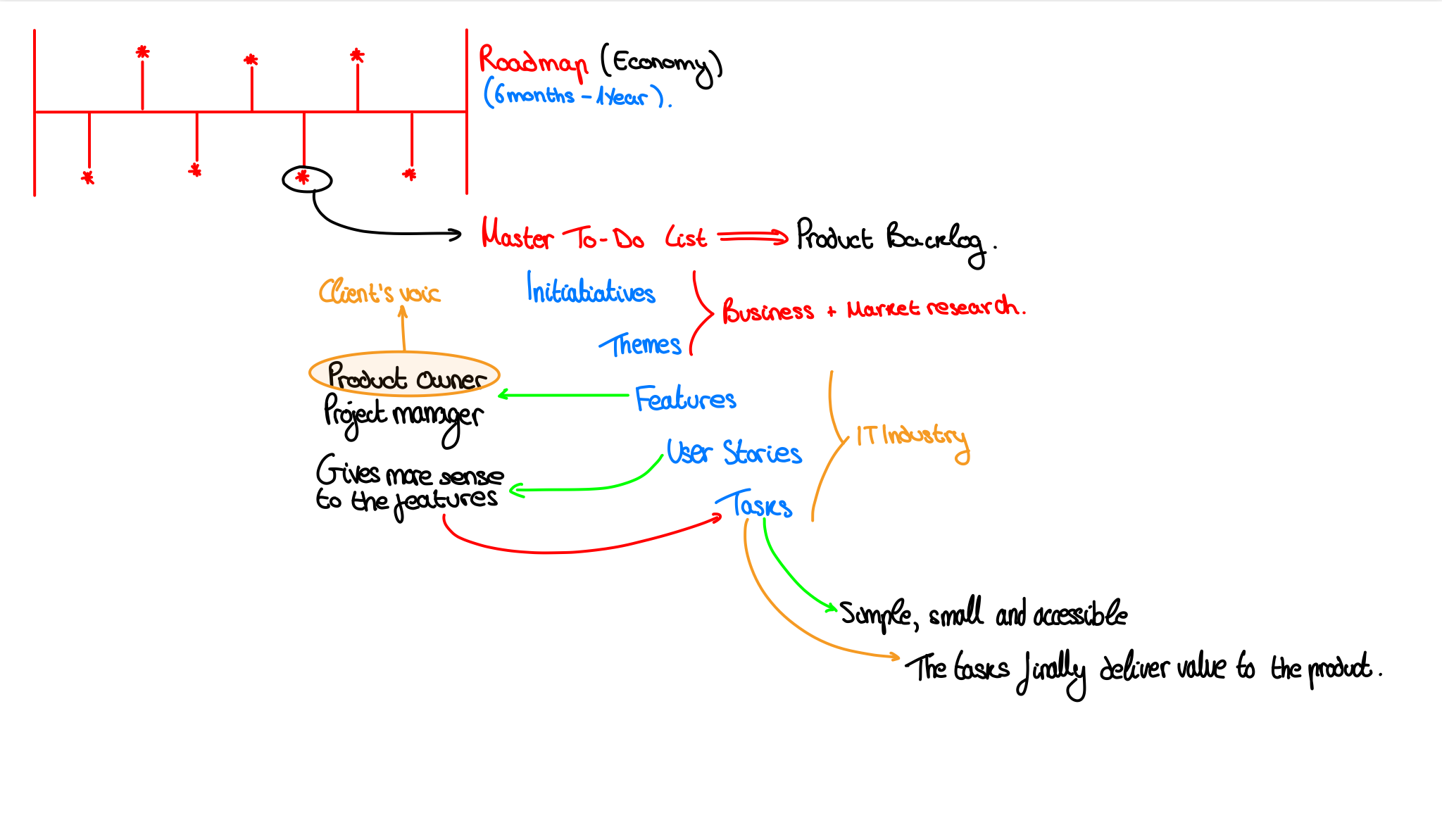
Project analysis slide 10
Notes:
SLIDE 20
The goals and aims set in the roadmap are focused on the business and economic growth of the company more than technical tasks.
The Product Backlog is divided in the following way:
1. Initiatives
2. Themes
3. Features
4. User Stories
5. Tasks
SLIDE 21
This is done in Program Increments Planning (PI Planning). Here, they take 3 months to work on the first features dividing it in 6 sprints of two weeks each. It is important to know that the number of features might be incremented. This is why the project manager has to lead the team as most efficiently as possible.
Furthermore, the features are broken up into User Stories. This gives more sense to the features. It is easier to understand and to divide once more into tasks. This way the tasks are simple, small and accessible. The tasks finally deliver value to the product.

Slide 30
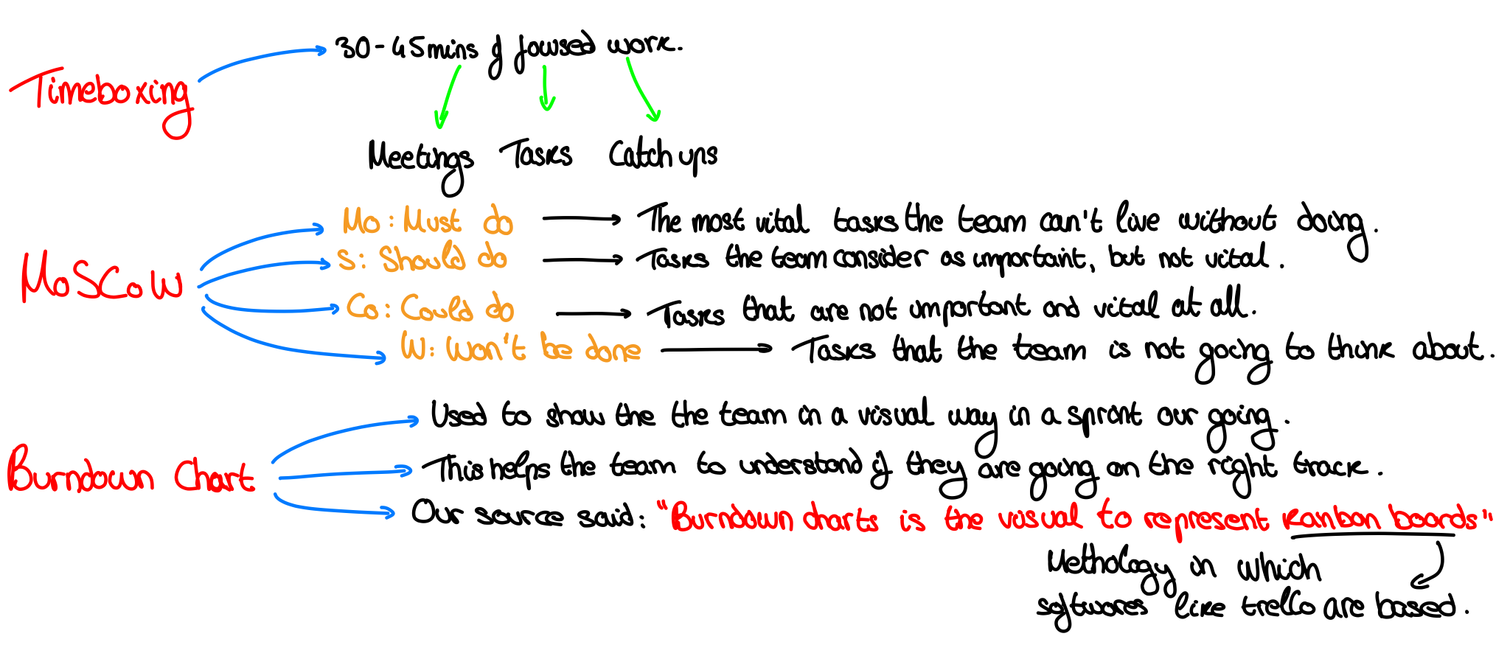
Project analysis slide 10
Notes:
SLIDE 20
The goals and aims set in the roadmap are focused on the business and economic growth of the company more than technical tasks.
The Product Backlog is divided in the following way:
1. Initiatives
2. Themes
3. Features
4. User Stories
5. Tasks
SLIDE 21
This is done in Program Increments Planning (PI Planning). Here, they take 3 months to work on the first features dividing it in 6 sprints of two weeks each. It is important to know that the number of features might be incremented. This is why the project manager has to lead the team as most efficiently as possible.
Furthermore, the features are broken up into User Stories. This gives more sense to the features. It is easier to understand and to divide once more into tasks. This way the tasks are simple, small and accessible. The tasks finally deliver value to the product.
SLIDE 23
He also introduced to us the MoSCoW management method. This method is really similar to the technique mentioned earlier to assign priorities to tasks. MoSCoW stands for Must, Should, Could, Won’t be (this time) and it helps with the prioritization of time. This prioritization is assigned by the Product Owner. It helps a lot to the team, as it shows them how to maximize their time.

Slide 31
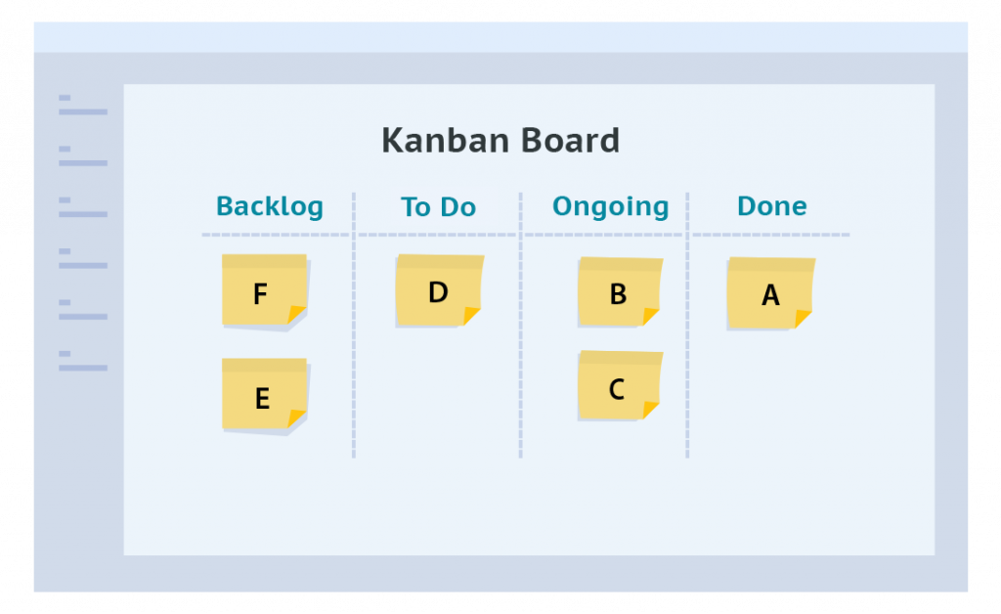
Project analysis slide 10
Notes:
SLIDE 20
The goals and aims set in the roadmap are focused on the business and economic growth of the company more than technical tasks.
The Product Backlog is divided in the following way:
1. Initiatives
2. Themes
3. Features
4. User Stories
5. Tasks
SLIDE 21
This is done in Program Increments Planning (PI Planning). Here, they take 3 months to work on the first features dividing it in 6 sprints of two weeks each. It is important to know that the number of features might be incremented. This is why the project manager has to lead the team as most efficiently as possible.
Furthermore, the features are broken up into User Stories. This gives more sense to the features. It is easier to understand and to divide once more into tasks. This way the tasks are simple, small and accessible. The tasks finally deliver value to the product.

Slide 32
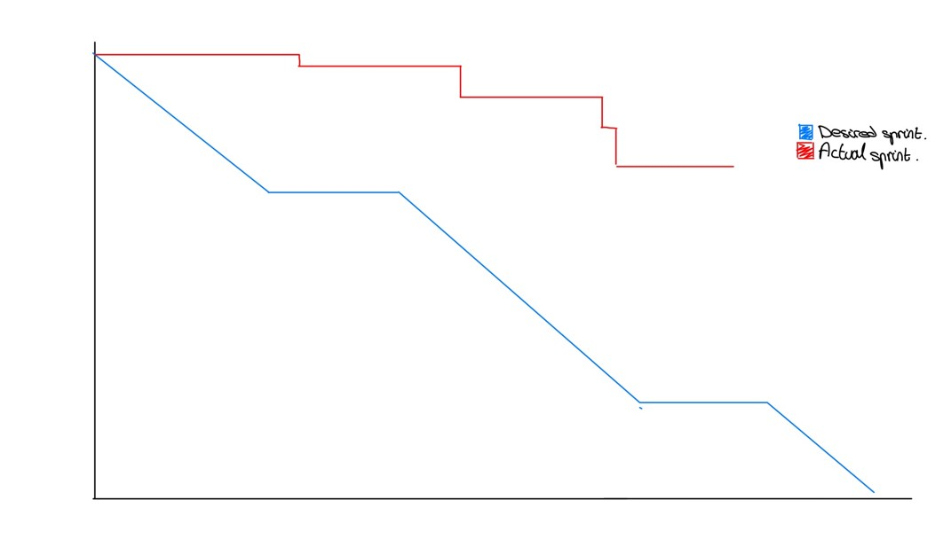
Project analysis slide 10
Notes:
SLIDE 20
The goals and aims set in the roadmap are focused on the business and economic growth of the company more than technical tasks.
The Product Backlog is divided in the following way:
1. Initiatives
2. Themes
3. Features
4. User Stories
5. Tasks
SLIDE 21
This is done in Program Increments Planning (PI Planning). Here, they take 3 months to work on the first features dividing it in 6 sprints of two weeks each. It is important to know that the number of features might be incremented. This is why the project manager has to lead the team as most efficiently as possible.
Furthermore, the features are broken up into User Stories. This gives more sense to the features. It is easier to understand and to divide once more into tasks. This way the tasks are simple, small and accessible. The tasks finally deliver value to the product.
SLIDE 26
Explain what each Burndown chart.

Slide 33
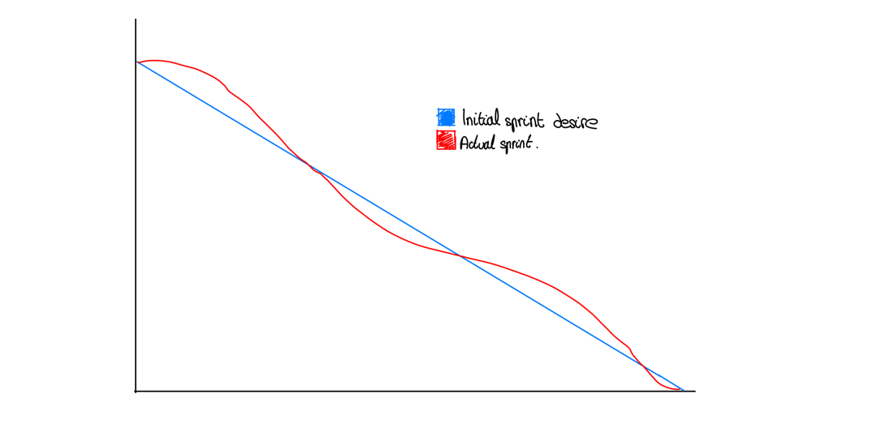
Project analysis slide 10
Notes:
SLIDE 20
The goals and aims set in the roadmap are focused on the business and economic growth of the company more than technical tasks.
The Product Backlog is divided in the following way:
1. Initiatives
2. Themes
3. Features
4. User Stories
5. Tasks
SLIDE 21
This is done in Program Increments Planning (PI Planning). Here, they take 3 months to work on the first features dividing it in 6 sprints of two weeks each. It is important to know that the number of features might be incremented. This is why the project manager has to lead the team as most efficiently as possible.
Furthermore, the features are broken up into User Stories. This gives more sense to the features. It is easier to understand and to divide once more into tasks. This way the tasks are simple, small and accessible. The tasks finally deliver value to the product.
SLIDE 26
Explain what each Burndown chart.

Slide 34

Time Management used by Students

Slide 35

Project analysis slide 10
Maintain a Master To-DO List
Break large tasks into smaller tasks
Know-how and where you spend your time so you can make better time management choices
Expect interruptions but be prepared to professionally manage them
Notes:
SLIDE 20
The goals and aims set in the roadmap are focused on the business and economic growth of the company more than technical tasks.
The Product Backlog is divided in the following way:
1. Initiatives
2. Themes
3. Features
4. User Stories
5. Tasks
SLIDE 21
This is done in Program Increments Planning (PI Planning). Here, they take 3 months to work on the first features dividing it in 6 sprints of two weeks each. It is important to know that the number of features might be incremented. This is why the project manager has to lead the team as most efficiently as possible.
Furthermore, the features are broken up into User Stories. This gives more sense to the features. It is easier to understand and to divide once more into tasks. This way the tasks are simple, small and accessible. The tasks finally deliver value to the product.
SLIDE 26
Explain what each Burndown chart.
SLIDE 27
When we study we also want to be as efficient as possible. There are lots of homework and study to do in an evening. We have to be disciplined enough to do the work efficiently. To do so I have some techniques to help you as well as sharing my experience using some of these techniques.

Slide 36
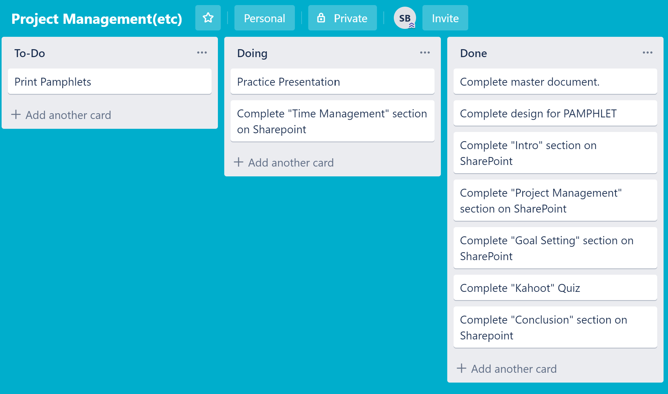
Project analysis slide 10
Notes:
SLIDE 20
The goals and aims set in the roadmap are focused on the business and economic growth of the company more than technical tasks.
The Product Backlog is divided in the following way:
1. Initiatives
2. Themes
3. Features
4. User Stories
5. Tasks
SLIDE 21
This is done in Program Increments Planning (PI Planning). Here, they take 3 months to work on the first features dividing it in 6 sprints of two weeks each. It is important to know that the number of features might be incremented. This is why the project manager has to lead the team as most efficiently as possible.
Furthermore, the features are broken up into User Stories. This gives more sense to the features. It is easier to understand and to divide once more into tasks. This way the tasks are simple, small and accessible. The tasks finally deliver value to the product.
SLIDE 26
Explain what each Burndown chart.
SLIDE 27
When we study we also want to be as efficient as possible. There are lots of homework and study to do in an evening. We have to be disciplined enough to do the work efficiently. To do so I have some techniques to help you as well as sharing my experience using some of these techniques.

Slide 37

Project analysis slide 10
Notes:
SLIDE 20
The goals and aims set in the roadmap are focused on the business and economic growth of the company more than technical tasks.
The Product Backlog is divided in the following way:
1. Initiatives
2. Themes
3. Features
4. User Stories
5. Tasks
SLIDE 21
This is done in Program Increments Planning (PI Planning). Here, they take 3 months to work on the first features dividing it in 6 sprints of two weeks each. It is important to know that the number of features might be incremented. This is why the project manager has to lead the team as most efficiently as possible.
Furthermore, the features are broken up into User Stories. This gives more sense to the features. It is easier to understand and to divide once more into tasks. This way the tasks are simple, small and accessible. The tasks finally deliver value to the product.
SLIDE 26
Explain what each Burndown chart.
SLIDE 27
When we study we also want to be as efficient as possible. There are lots of homework and study to do in an evening. We have to be disciplined enough to do the work efficiently. To do so I have some techniques to help you as well as sharing my experience using some of these techniques.

Slide 38



Project analysis slide 10
How the IT Industry organizes projects
How to use these techniques to work efficiently
How to manage your projects, goals and time efficiently
Notes:
SLIDE 20
The goals and aims set in the roadmap are focused on the business and economic growth of the company more than technical tasks.
The Product Backlog is divided in the following way:
1. Initiatives
2. Themes
3. Features
4. User Stories
5. Tasks
SLIDE 21
This is done in Program Increments Planning (PI Planning). Here, they take 3 months to work on the first features dividing it in 6 sprints of two weeks each. It is important to know that the number of features might be incremented. This is why the project manager has to lead the team as most efficiently as possible.
Furthermore, the features are broken up into User Stories. This gives more sense to the features. It is easier to understand and to divide once more into tasks. This way the tasks are simple, small and accessible. The tasks finally deliver value to the product.
SLIDE 26
Explain what each Burndown chart.
SLIDE 27
When we study we also want to be as efficient as possible. There are lots of homework and study to do in an evening. We have to be disciplined enough to do the work efficiently. To do so I have some techniques to help you as well as sharing my experience using some of these techniques.

Slide 39


